Slide 1
functions, input & output, importing modules.
Week 2 | Lecture 1 (2.1)
Upcoming
Lab 0 Due 11:59 pm Friday.
Lab 1 Released Thursday 6:00 pm.
Reflection 2 Released Friday 6:00 pm.
Tutorial and Practical sessions running all week.

Slide 2
This Week’s Content
Lecture 2.1
Functions, input & output, importing modules
Lecture 2.2
Defining your own function
Lecture 2.3
Design Problem: Forward Kinematics

Slide 3
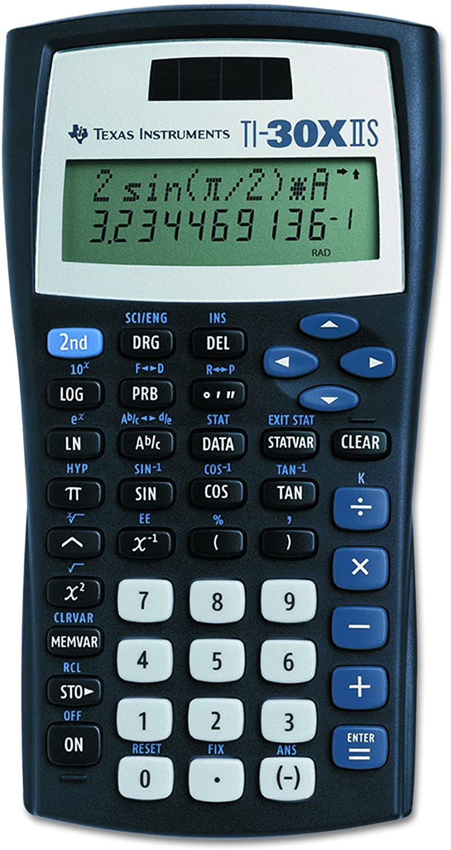
What is a function?
A function is a piece of code that you can “call” repeatedly to do one thing.
Think about the sine key on your calculator. It takes in an angle, does some calculations and returns the sine of that angle.
Python has built-in functions (today), but programmers can also create their own user-defined functions (next lecture).

Slide 4
Why do we write functions?
Let’s consider our sine function.
In Python, this could take 10 or more line of code to compute.
If you have to compute the sine of an angle multiple times in your code, this means you have to repeat the same 10 lines of code over and over and OVER again!
This is both inefficient and it creates more opportunities to bugs (mistakes) to creep into your code.
Open your notebook
Click Link:
1. Why do we write functions?

Slide 5
Why do we write functions?
Reuse:
The practice of using the same piece of code in multiple applications.
Abstraction:
A technique for managing the complexity of the code (how much do we really need to know?).
model.fit(X, y) → This could train a deep neural network.
Collaboration:
Easy to read, Easy to modify, Easy to maintain.
#cleancode

Slide 6
Calling Functions
In Python names of variables and functions use low case and underscores.
function_name
Function_Name
FunctionName
"snake case" or
"pothole case“?
The general form of a function call:
Terminology
argument: a value given to a function.
pass: to provide an argument to a function.
call: ask Python to execute a function (by name).
return: give a value back to where the function was called from.
function_name(arguments)
function_name()
function_name
Would not result in a function call.

Slide 7
Calling Functions
The stuff we pass to the function.
Arguments
The general form of a function call:
Terminology
argument: a value given to a function.
pass: to provide an argument to a function.
call: ask Python to execute a function (by name).
return: give a value back to where the function was called from.
function_name(arguments)
Function
Call
Function
()
function_name()
function_name
Would not result in a function call.
The stuff the function returns to us after we call it.
Returns

Slide 8
Calling Functions
Open your notebook
Click Link:
2. Function Call
The general form of a function call:
Terminology
argument: a value given to a function.
pass: to provide an argument to a function.
call: ask Python to execute a function (by name).
return: give a value back to where the function was called from.
function_name(arguments)

Slide 9
Back to evaluation and expressions
Last week we learned about the assignment statement (=).
Remember, the value of the expression on the right-hand side (RHS) of the = sign is figured out first and then assigned to the variable on the left-hand side.
This also applies if the thing on the RHS is a function!
First, the function is called while passing it an argument.
x = abs(-20+5)
Then, what the function returns is assigned to x.

Slide 10
Back to evaluation and expressions
x = abs(-20+5)
Last week we learned about the assignment statement (=).
Remember, the value of the expression on the right-hand side (RHS) of the = sign is figured out first and then assigned to the variable on the left-hand side.
This also applies if the thing on the RHS is a function!
The stuff we pass to the function.
Arguments
?
Function
?
The stuff the function returns to us after we call it.
Returns
?

Slide 11
Back to evaluation and expressions
x = abs(-20+5)
Last week we learned about the assignment statement (=).
Remember, the value of the expression on the right-hand side (RHS) of the = sign is figured out first and then assigned to the variable on the left-hand side.
This also applies if the thing on the RHS is a function!
The stuff we pass to the function.
Arguments
-15
Function
abs
The stuff the function returns to us after we call it.
Returns
15

Slide 12
Back to evaluation and expressions
Last week we learned about the assignment statement (=).
Remember, the value of the expression on the right-hand side (RHS) of the = sign is figured out first and then assigned to the variable on the left-hand side.
This also applies if the thing on the RHS is a function!
Open your notebook
Click Link:
3. Back to Evaluation and Expressions

Slide 13
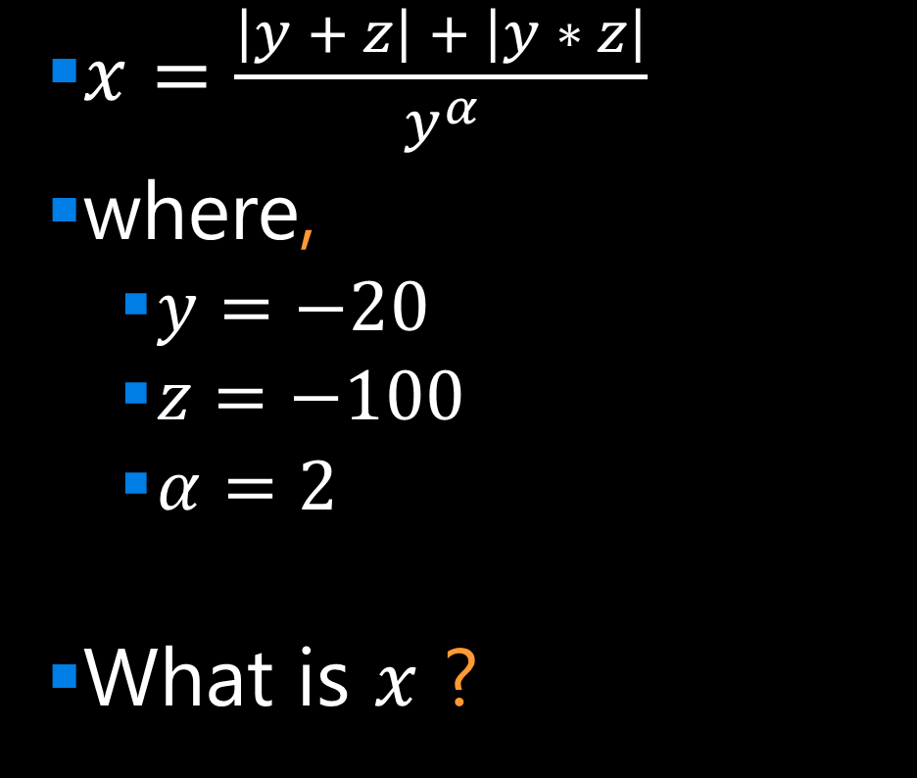
Breakout Session 1
$x=\frac{\left|y + z\right| + \left|y ∗ z\right|}{y^{α}}$
where,
$y=−20$
$z=−100$
$α=2$
What is $x$ ?
Open your notebook
Click Link:
4. Breakout Session 1

Slide 14
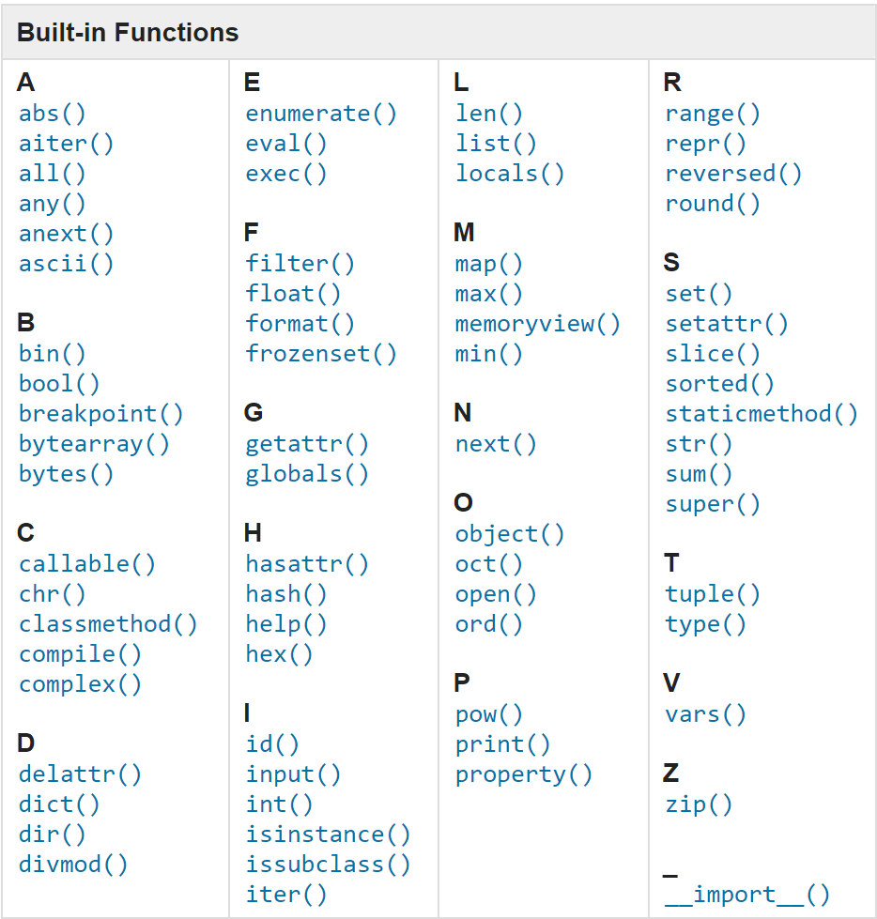
Built-in Functions
The function_name is the name of the function (like sin or print).
Python has many built-in functions. Learn more about them here.

Slide 15
Built-in Functions
The function_name is the name of the function (like sin or print).
Python has many built-in functions. Learn more about them here.
Open your notebook
Click Link:
5. Built-in Functions

Slide 16
Function Help
To get information about a particular function, call help and pass the function as the argument.
help is one of Python’s built-in functions.
help(abs)
help(abs())
Open your notebook
Click Link:
6. Function Help
Notice how we’re not calling the function.

Slide 17
Output
Python has a built-in function named print for displaying messages to the user.
The general form of a print function call:
The arguments can be of type int, float, strings and others we will discuss next week.
Open your notebook
Click Link:
7. Output
print(arguments)

Slide 18
Input
Python has a built-in function named input for reading inputs from the user.
The general form of an input function call:
The argument is the text you want displayed to the user.
“What is your name?”
The value returned by the input function is always a string.
Open your notebook
Click Link:
8. Input
input(argument)

Slide 19
Breakout Session 2
Write code to print out the following text:
Where you see curly brackets {} you need to use the input function to prompt the user to enter that information.
Open your notebook
Click Link:
9. Breakout Session 2
"Hello, my name is {} and I'm hoping to get a grade of {} in APS106 this term."

Slide 20
Importing Functions and Modules
Not all useful functions are built-in and they must be imported.
Groups of functions are stored in separate Python files, which are called modules.
Some modules come pre-installed with Python and other need to be installed separately.
For example, there are a lot of machine learning methods implemented in the scikit-learn modules.
To get access to the functions in a module, you need to import the module.

Slide 21
Importing Functions and Modules
The general for of an import statement is:
import module_name
To access a function within a module:
module_name.function_name
The dot is an operator:
Look up the object that the variable to the left of the dot refers to.
In that object, find the name that occurs to the right of the dot.
import math
math.sqrt(16)

Slide 22
Importing Functions and Modules
The general for of an import statement is:
import module_name
To access a function within a module:
module_name.function_name
Open your notebook
Click Link:
10. Importing Function and Modules

Slide 23
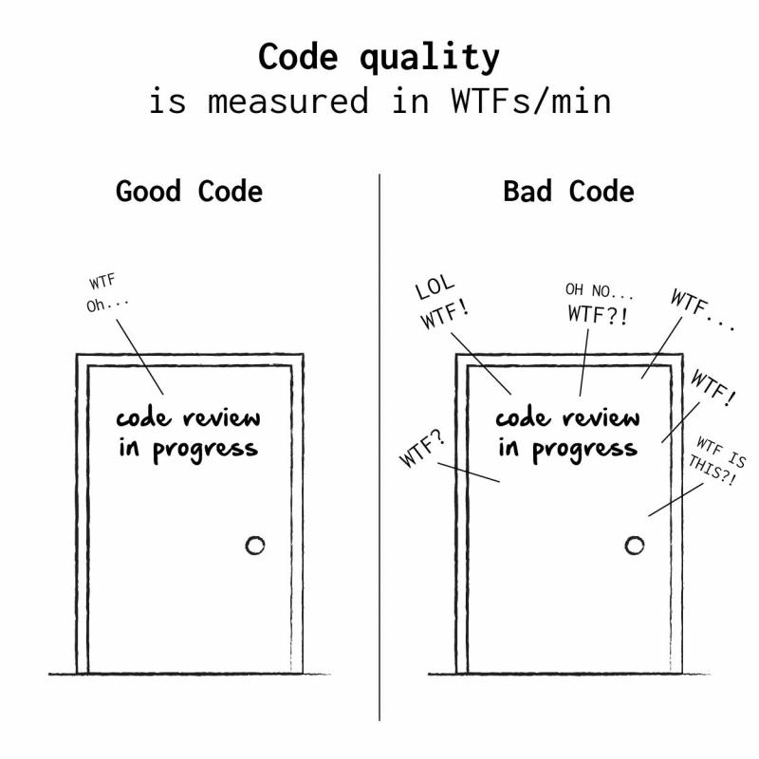
Defining Your Own Functions
The real power of functions is in defining your own.
Good programs typically consist of many small functions that call each other.
If you have a function that does only one thing (like calculate the sine of an angle), it is likely not too large.
If its not too large, it will be easy to test and maintain.

Slide 24
Defining Your Own Functions
As a general rule, you should not write functions more than a 30 or 40 lines.
Smaller is better: 10 or less is good.
If you need something bigger, break it up into multiple functions.
#cleancode

Slide 25
Function Definitions
The general form of a function definition is:
def is a keyword, standing for definition. All function definitions must begin with def. The def statement must end with a colon.
function_name is the name you will use to call the function (like sin, abs but you need to create your own name).
parameters are the variables that get values when you call the function. You can have 0 or more parameters, separated by commas. Must be in parenthesis.
body is a sequence of commands like we've already seen (assignment, multiplication, function calls).
return ends the function and returns data (like the sine of an angle).
Important: all the lines of body must be indented. That is how Python knows that they are part of the function.
def function_name(parameters):
body
return
Colon
Indent
What are we returning?
(parameter1, parameter2, …)

Slide 26
Function Definitions
The general form of a function definition is:
Open your notebook
Click Link:
11. Defining Your Own Functions
Definition
Function Name
Colon
def function_body(parameters):
body
return
Indent
What are we returning?
(parameter1, parameter2, …)

Slide 27
PRACTICE!

Slide 28
functions, input & output, importing modules.
Week 2 | Lecture 1 (2.1)

